Slide 1
READ ME This template uses the font ‘Space Grotesk’ – be sure to download the font before making edits to the deck. Here’s the link to the ZIP file containing the font. If you cannot access the link above, you can download the font for free via Google Fonts.

Slide 2

.NET Conf
Focus on modern code

Slide 3
Minimal API + SPA, a perfect match
Aaron Powell

Slide 4




Notes:
We’re going to be building a single page app.
We’ll start with something in the current generation of tooling like Vite
Vite allows us to pick from a variety of different frontend libraries such as React, Svelte, Vue, etc.

Slide 5

fetch()
ASP.NET Minimal API
Notes:
But what about the backend for our application? Unless we’re building a completely static website we’re probably going to need to get some data for it.
This is where .NET can come in, specifically ASP.NET Minimal API.
With Minimal API we’re able to setup HTTP endpoints that we can make calls to from our JavaScript frontend via fetch, or using wrapper library like axios

Slide 6

Notes:
Let’s talk about tools, for this application VS Code is a great choice

Slide 7
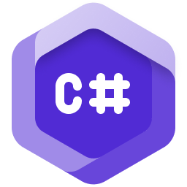


Notes:
We can then add any extension that we want, such as C# DevKit, Prettier, ES Lint, and any of the few dozen out there

Slide 8
Time to code
https://aka.ms/netconf23/studentrepo

Slide 9
Student Zone Repository
https://aka.ms/netconf23/studentrepo
Foundational C# Certification
https://aka.ms/csharp-certification
.NET Beginner Videos
https://aka.ms/dotnetvideos
Watch .NET Conf, November 14-16
https://aka.ms/dotnetconf23-studentzone

